Slide 1
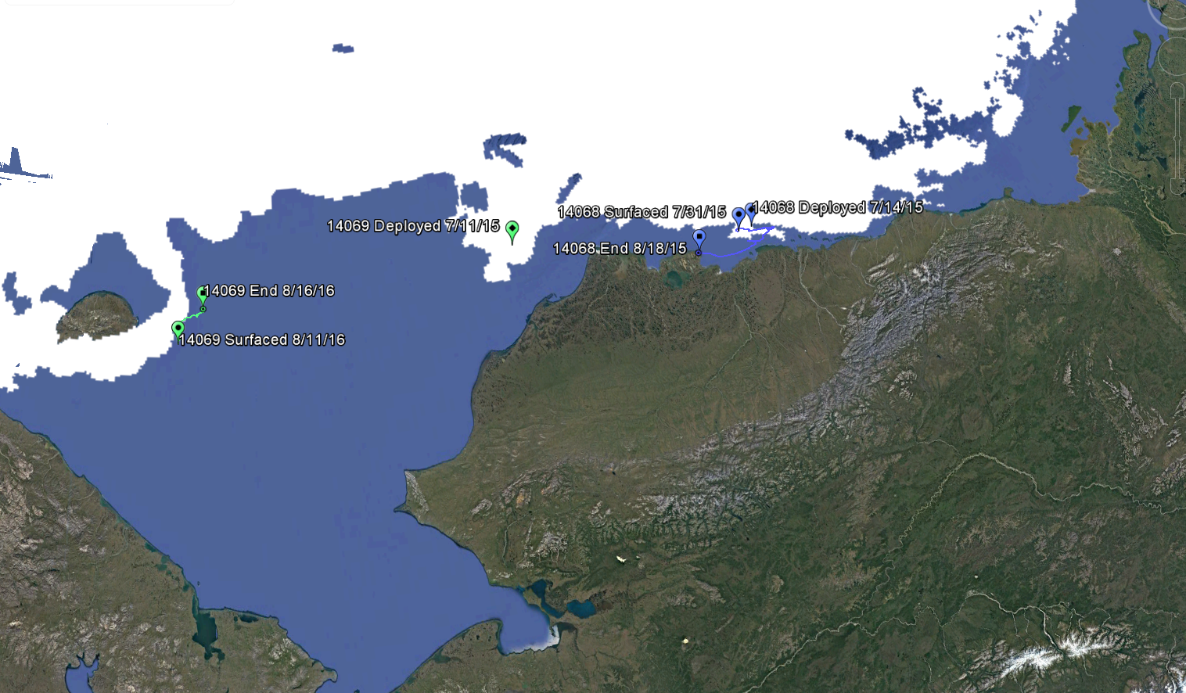
2015 Deployment Locations
Notes:
2 Prototype buoys deployed from USCGC Healy in July 2015
One surfaced 2 weeks after deployment
One unit (thought to be lost) transmitted 13 months after deployment
MASIE shown for 7/15/15. (Deployments were on 7/11/17 and 7/15/17)

Slide 2
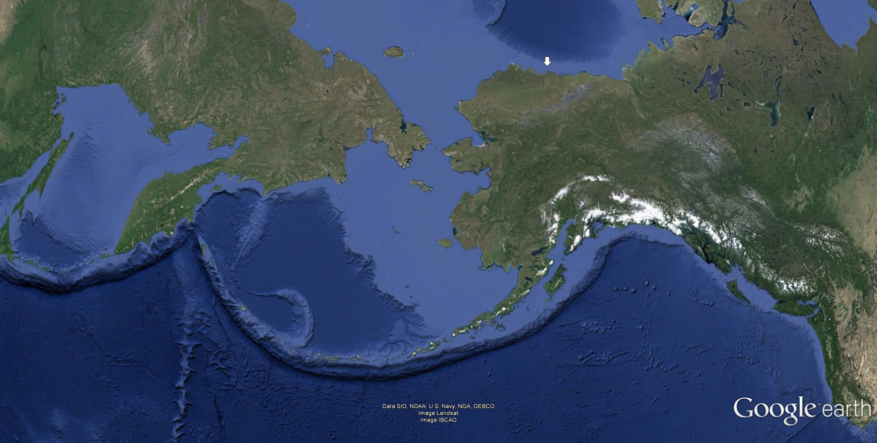
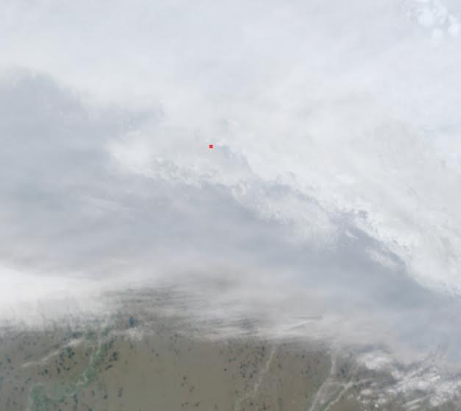
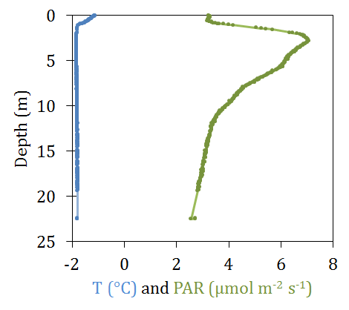
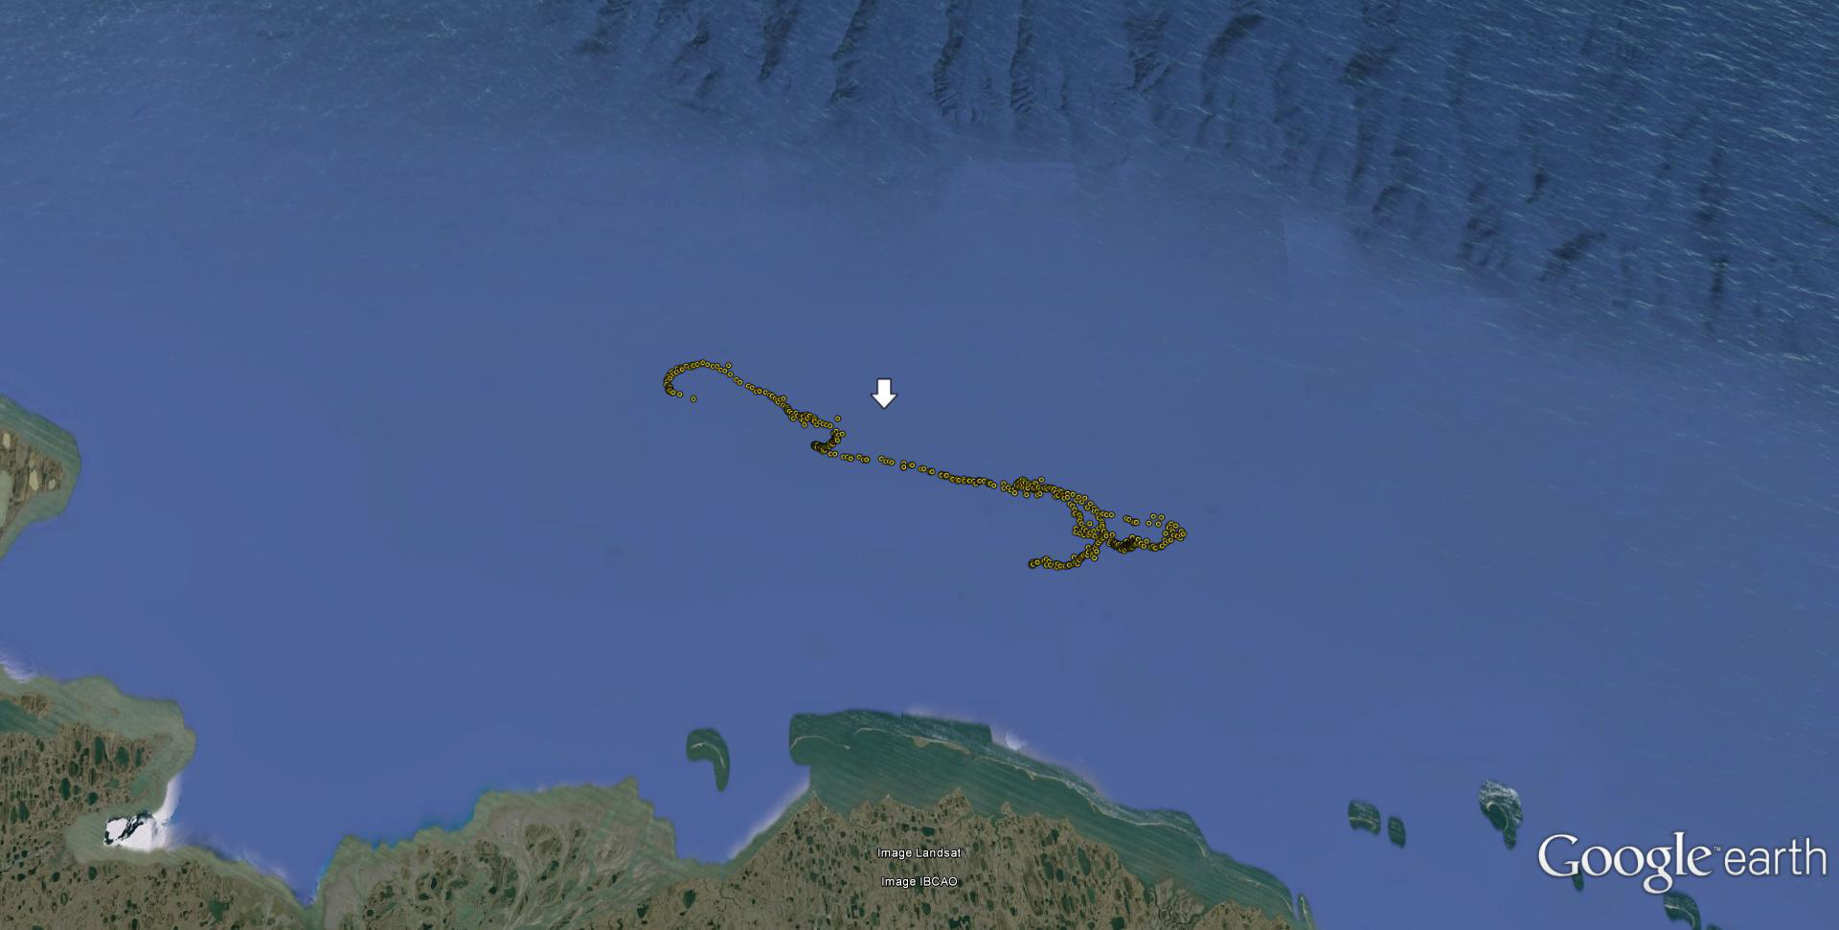
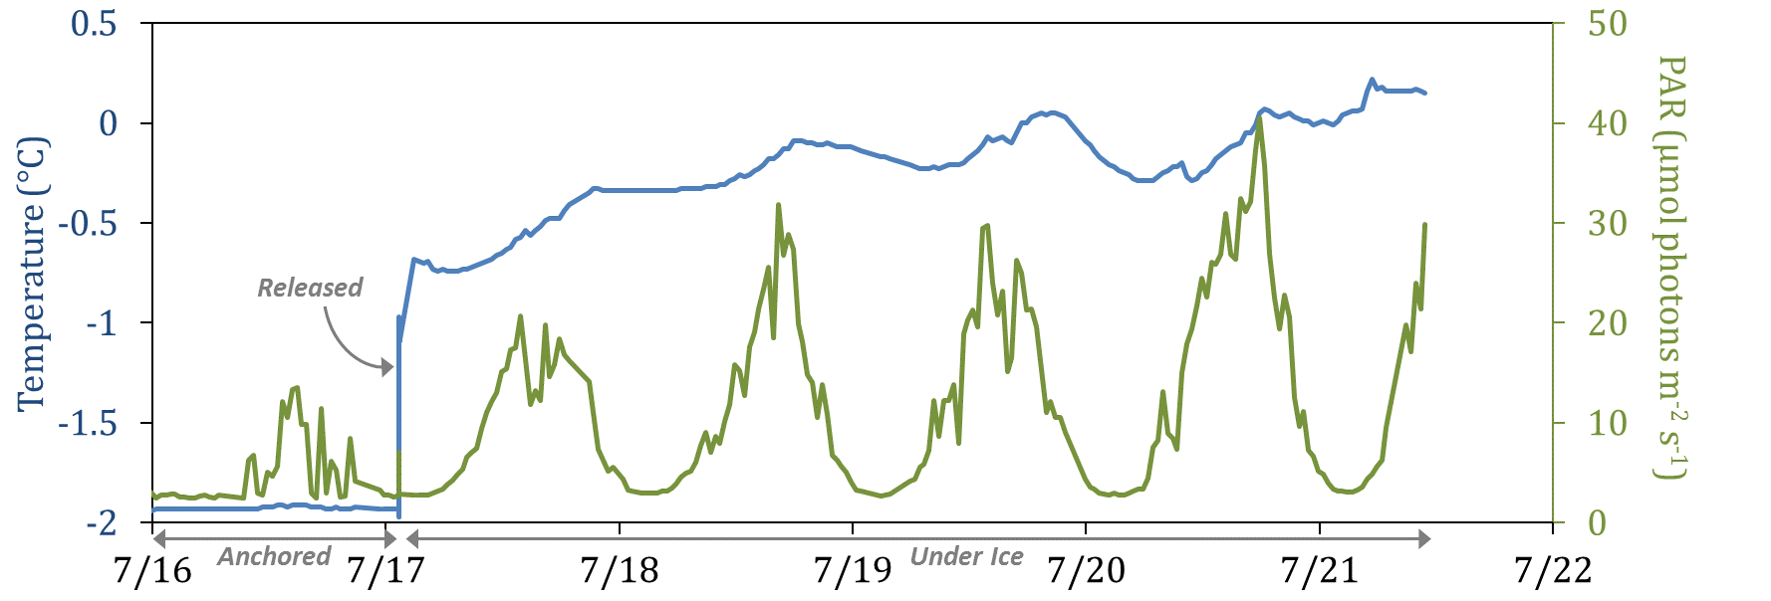
Unit 14068 Data (2015 Prototype)
Deploy
Transmit
Notes:
Pop-up floats (sometimes referred to as ExFloats or EXpendable Ice-Tracking (EXIT) floats) are designed for observation of the water-ice boundary, and to study how ice retreat modifies physical and environmental factors over time. Pop-up floats are moored to the bottom during fall (ice-free) months and sequentially released according to pre-set timers during the winter and spring (ice-covered) months. The floats collect data while moored along the bottom, during ascent through the water column, and while positioned directly underneath the ice. Once the float encounters open water, all data collected is telemetered to shore.
***local Alaska time, so you can see that we popped-up at night. Note that light penetrated the sea-ice to the bottom (only ~20 m depth here).

Slide 3
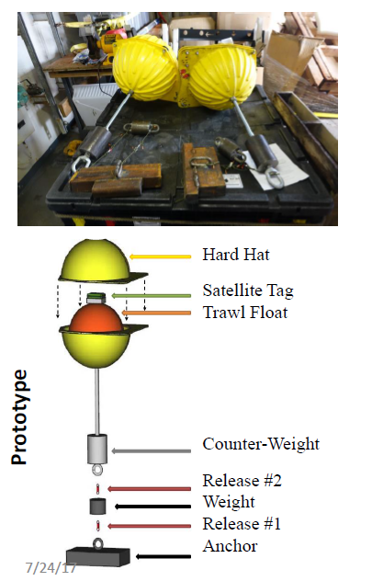
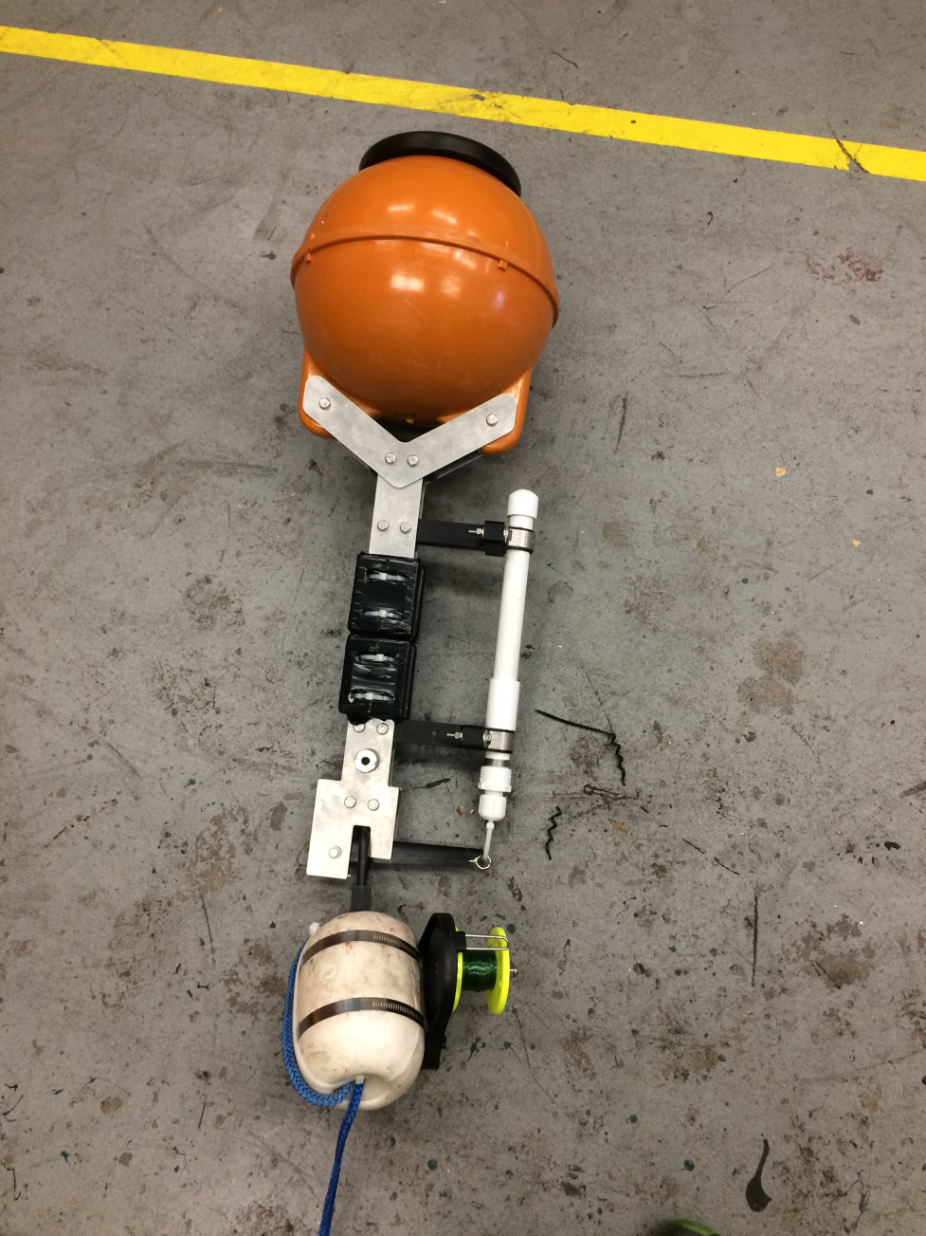
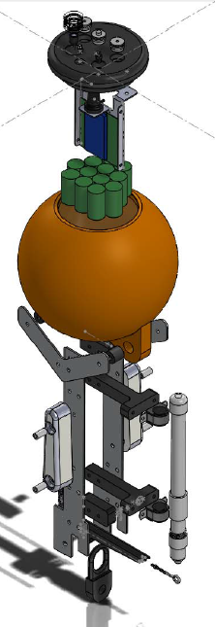
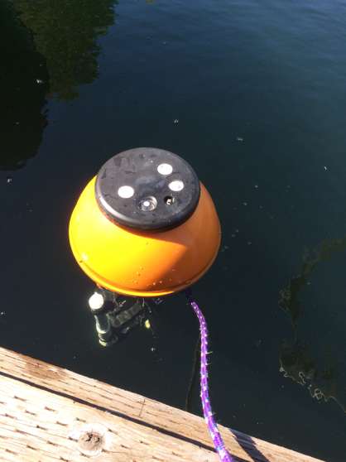
Prototype (2015)
Development – Instrument Built In-House
In House Build (2017)
Notes:
In order to reduce production costs for these expendable floats, they have been custom designed in‐house by PMEL. A number of novel cost‐saving design features have been integrated to achieve a cost per float of ~$2,000 ‐ such as low‐cost pressure housings, commercial off‐the‐shelf electronics and a load reducing mechanism to utilize burn wire releases. Despite cost‐reductions, the floats still provide high‐quality data, measuring temperature to ± 0.01°C accuracy, depth to ± 0.21m accuracy, and PAR to ± 3% accuracy, as well as tilt angle and GPS location. They transmit data to shore using an on‐board Iridium modem.
All electrical, mechanical, and software designs for the floats have been completed, and six units have been constructed. One was deployed in the Chukchi Sea in September 2016, but never heard from (likely software issues). The other five floats were deployed in the Bering Sea in September 2017.

Slide 4
2017 Deployment
5 Units Deployed on DY17-08
Deployed 9/27/17 approx. 20nm east of M5
Buoys will release late Feb/early March 2018
Temp, PAR, Depth
Expectation is that buoys will flow south and melt out relatively quickly due to currents and ice movement (Phyllis)
Ice flows will be tracked using satellite data to determine position while under ice

